Slide 1

Day 5:
Random Quote Generator
Introduction
Notes:
Photo by Randy Tarampi on Unsplash

Slide 2

Your 6-Day Success Plan
You have done this!
Day 0 (30 mins):
Roadmap to Software Dev
Learn the pros of being software dev
Learn the step by step to be software dev

Slide 3
Your 6-Day Success Plan
You also have done this!
Day 1 (1h):
Learn creating a website using HTML
Create Your First Website
Understand how websites understand HTML
Use HTML to create links & texts
Build a resume website

Slide 4
Your 6-Day Success Plan
You also have done done this!
Day 2 (1h):
Learn to style a website using CSS
Styling Websites
Add your profile picture for employers!
Learn to create buttons and design them
Build a Link in Bio project

Slide 5
Your 6-Day Success Plan
You also have done done done this!
Day 3 (1h):
Learn data types such as numbers & strings
Build Interactive Website
Understand how to store data in variables
Learn how to show data
Create BMI calculator

Slide 6
Your 6-Day Success Plan
You also have done done done done this!
Day 4 (1h):
Learn to get user inputs
Better BMI
Understand how to make website interactive
Create better BMI calculator

Slide 7

Your 6-Day Success Plan
We are currently here
Day 5 (1h):
Learn how to create a list of quotes
Random Quote Generator
Show the quotes randomly
Create random quote generator

Slide 8
Your 6-Day Success Plan
Day 6 (1h):
Learn how to know if answer is correct
Quiz App
Show if the user got it right or not
Create quiz app

Slide 9
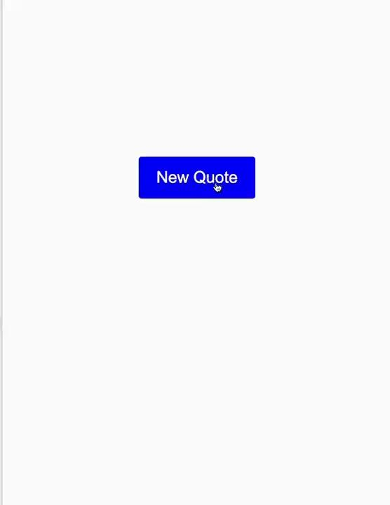
What you are building
A random quote generator that where you click on the button, and it shows quotes from famous people!
What you are learning:
- Learn how to create a list of quotes
- Show the quotes randomly
Demo project here.

Slide 10
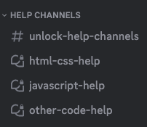
Need help?
We are happy to help with any issues, things you don’t understand in our Discord channel here.
Here is our full link:
https://discord.gg/yCrB7tfbhg
Once in discord, add your questions in our help channels.

Slide 11
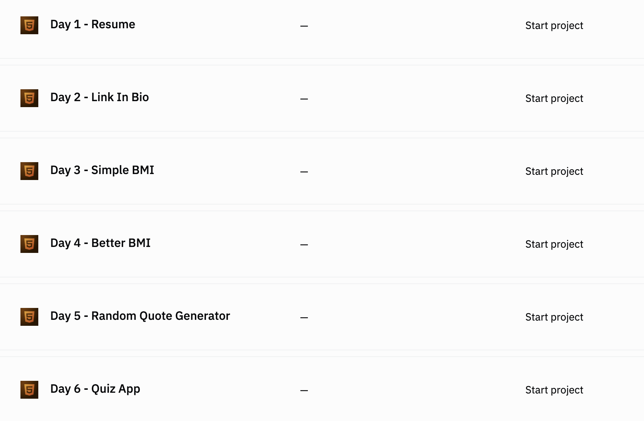

Go to our team dashboard: https://sig1.co/replit-6in6
You can click on Day 5 - Random Quote Generator

Slide 12
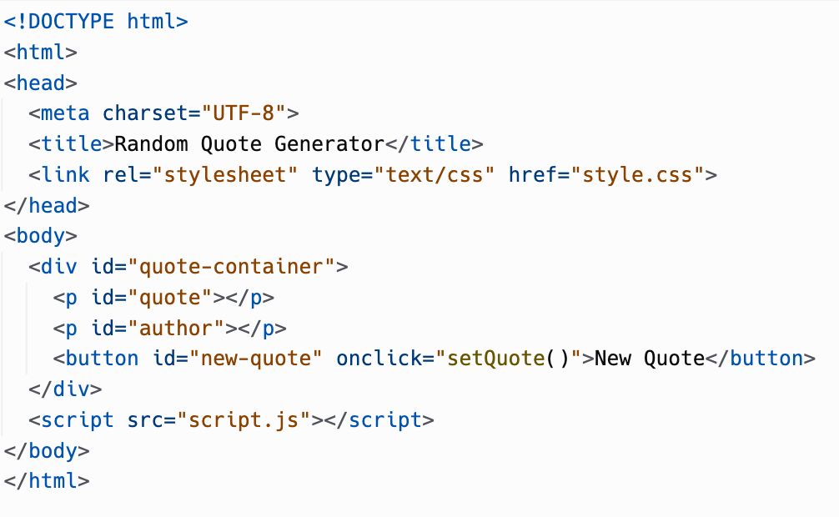
In index.html, update the code to this.

Slide 13
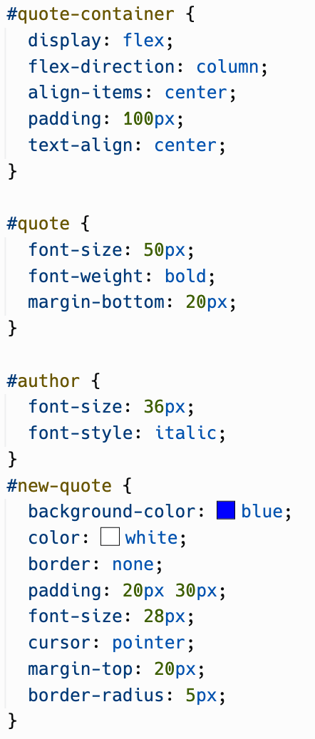
In style.css, update the code to this:

Slide 14
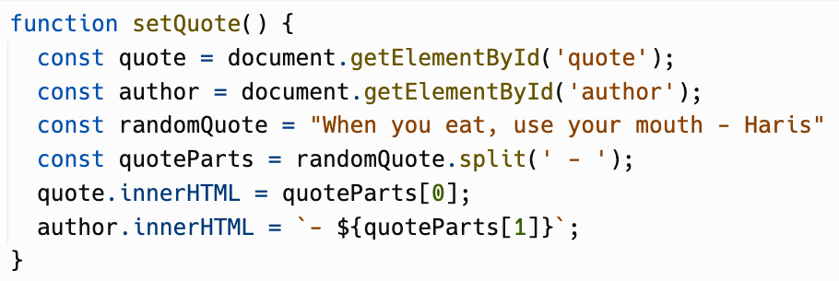
In script.js, add the code to this.

Slide 15
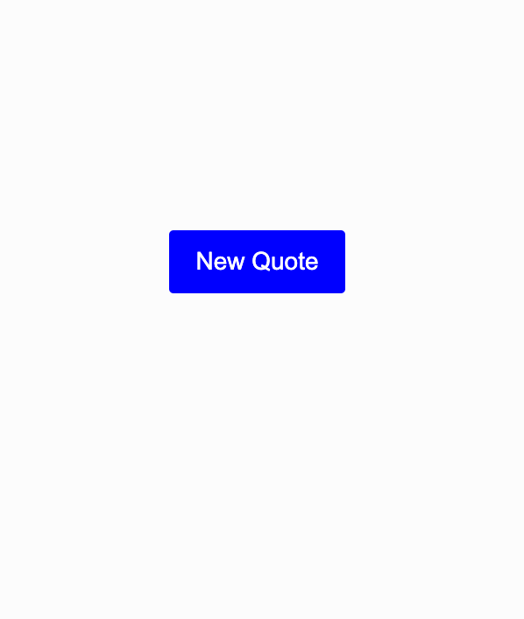
Run the project, and it should look like this. Click on the New Quote button…

Slide 16
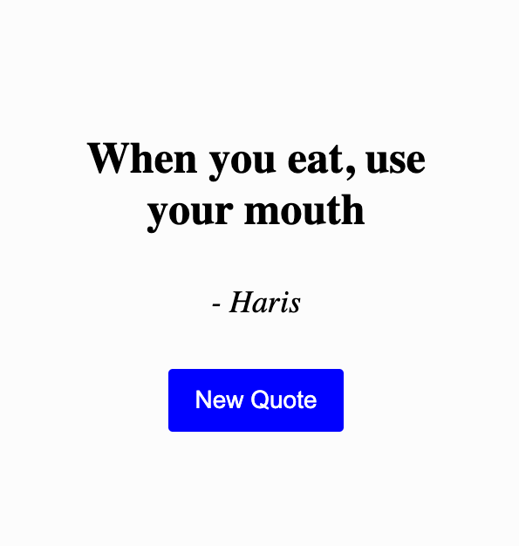
You should see a quote appear. Take a second to remember this inspiring quote. Okay, moving on to explain what happened…

Slide 17
div
div or division for short. It is a way to create a invisible container.
With this div, we can use it to style it’s children element (p, button)

Slide 18
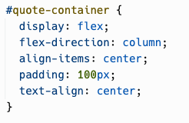
css
If you remember, when we want to style an element with id, we use the hash (#).
And the rest of the css properties are used to center the paragraph elements.

Slide 19
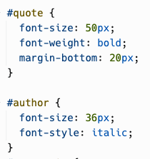
css
The id is useful when you have 2 of the same element, which in this case is the paragraph element.
For the quote, we have it bold using the font weight property.
While the author have italics using the font style.

Slide 20
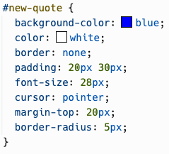
css
The button id #new-quote css is similar to the previous days. Just good practice.
Remember, perfect practice makes perfect.
And shitty practice, makes shit. Yeah…
Now moving to the script.js

Slide 21
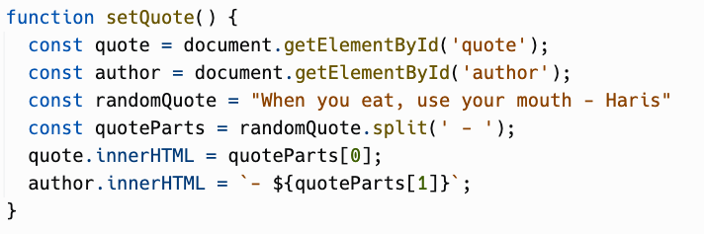
script.js
We get the quote and author element using the document.getElementById
Refresher, document refers to the whole website.
.getElementById is a function to get an element by its id.

Slide 22
randomQuote
What an inspiring quote. I mean, we create a variable name randomQuote.
However, we have quoteParts that uses the randomQuote.split(' - ')
What does this returns? Let’s add a console.log

Slide 23
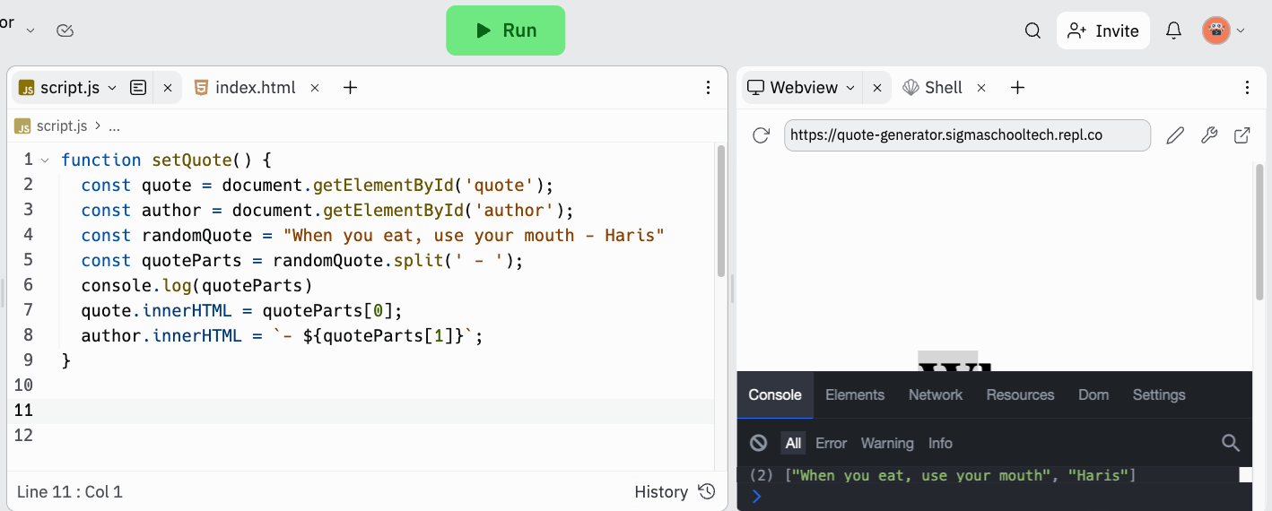
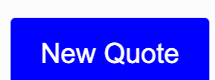
1. Add the console.log .
2. Run the code.
2
3
1
4
5

Slide 24
3. Toggle developer tools
4. Clock on the New Quote button
2
3
1
4
5

Slide 25
5. There should be a line of code that appears in the console. Let’s take a closer look
2
3
1
4
5

Slide 26
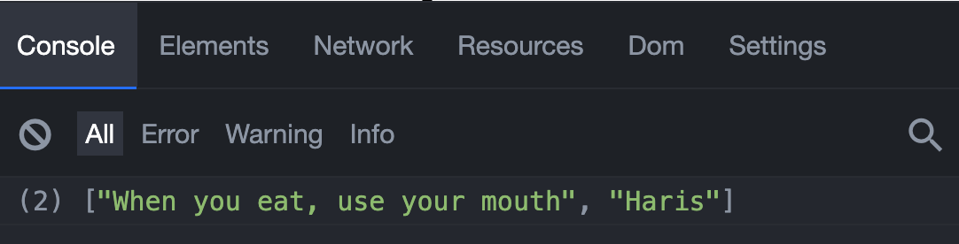
What is this amazing quote? I mean what is this line of code?
This is what called an array!

Slide 27
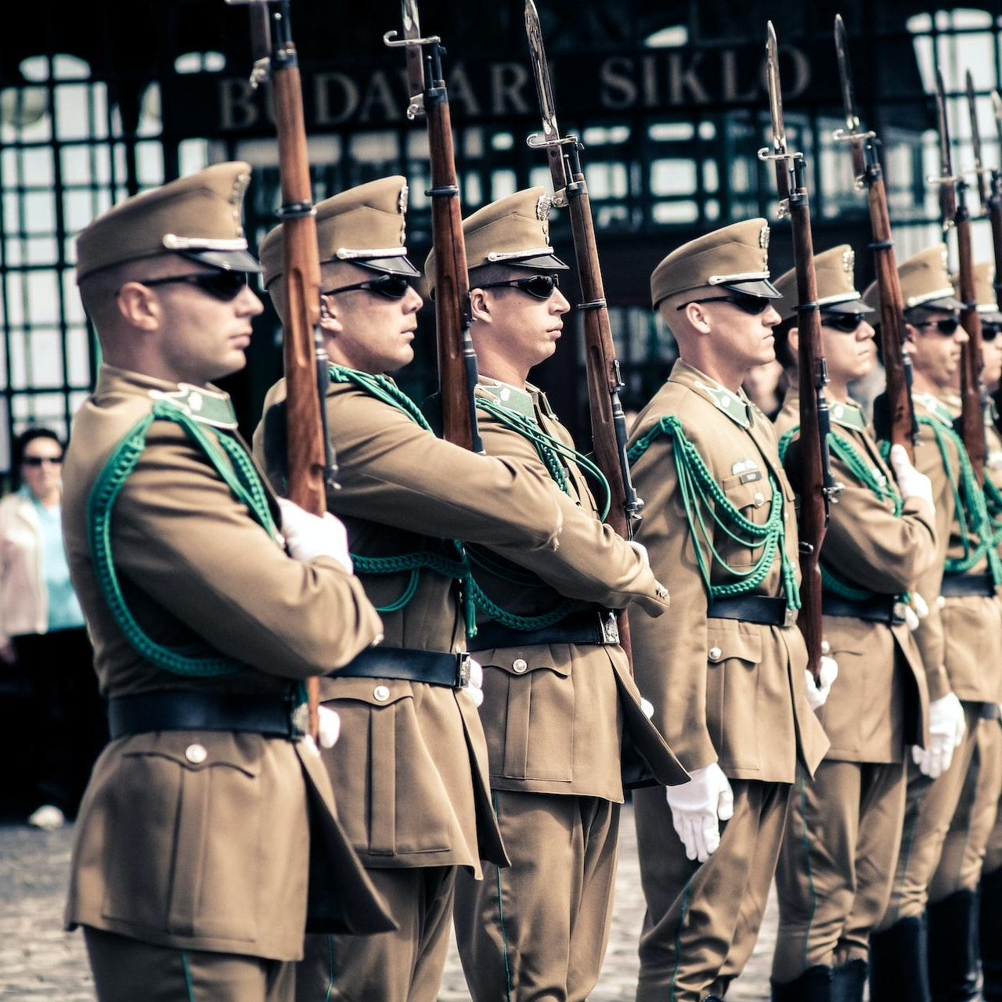
Arrays
Notes:
Photo by Eugene Zhyvchik on Unsplash

Slide 28
Arrays
Arrays it like a list. In this example, it is a list of strings or texts.
Arrays use square brackets [] and separate the values inside with commas.

Slide 29
.split
Essentially, the .split, well, split the string into 2 parts like this, looking for the separator (' - '):
Let’s move on the next lines.

Slide 30
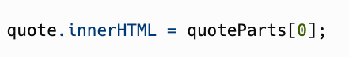
index
Just like an index number from your attendance list, we use it to get a specific text (in this example) in an array.
However, we refer the first index as number 0. Why? We count the number of space from the first text.
Therefore, the first text is 0 spaces from the first text, which means index 0.
And, the second text is 1 spaces from the first text, which means index 1.

Slide 31
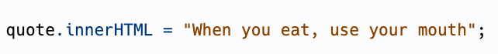
Access value from array
To get the the first text in the quoteParts, we also use the [] with the index number. Therefore, the quote.innerHTML would look like this:
Then for the author…

Slide 32
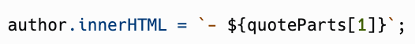
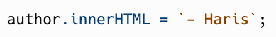
Access value from array
We have a template literal string. We can also add how we get a value from an array. The author.innerHTML would look like this:
Therefore, when we run the code…

Slide 33
Click on the new quote, it should show you a quote. However, how do we pop up another quote?

Slide 34
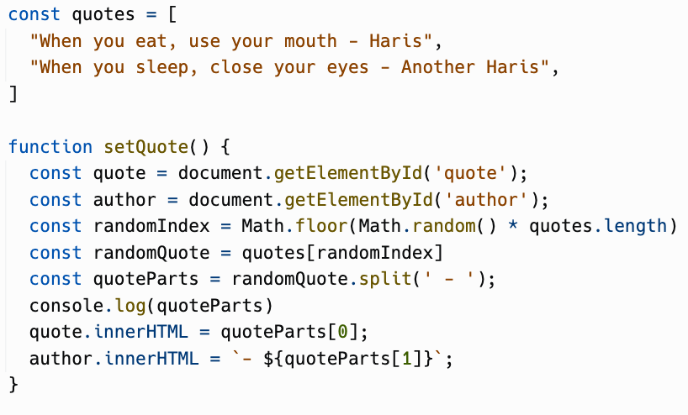
In script.js, update the code

Slide 35
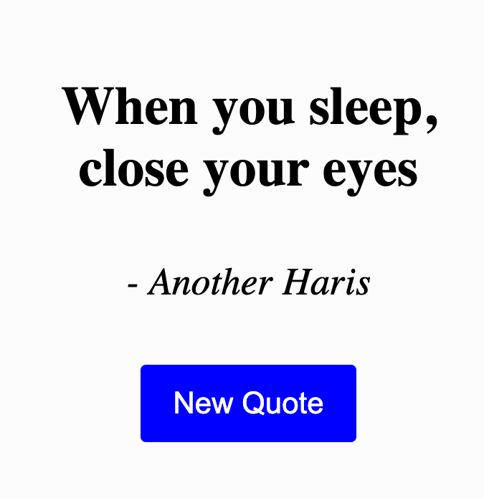
Run the project, click on the new quote button, and it should show you a random quote. Let’s explain what happened!

Slide 36
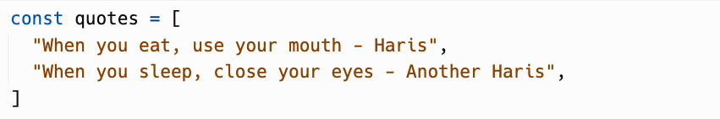
quotes
First, to store more than 1 quote, we create a quotes variable, with an array or list of quotes.

Slide 37
Random
To get a random number, we need to use Math. Similar how document contains functions, Math contains a bunch of math functions to use.
Functions such as floor and random. Let’s go find out what Math.random() and Math.floor() does.

Slide 38
Math.random()
It gives a random decimal point number between 0 to 1.
It could be 0.35144665525156893.
Or it could be 0.5136300693048088.
However, how do we choose a random index from our list of quotes?

Slide 39
quotes.length
We are able to get how many quotes using the quotes.length.
For example, if Math.random() gives us 0.1
And quotes.length give use 2
This gives us a 0.2. However, there is no index 0.2. Therefore, we need to round up to the nearest number using Math.floor()

Slide 40
Math.floor
It basically rounds up to the nearest whole number. This is how the whole thing looks like:
If Math.random returns 0.1:
If quotes.length returns 2:
And this would return us…

Slide 41
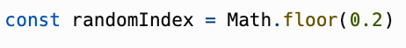
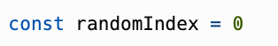
Math.floor
And this would return :
And Math.floor round up 0.2 to give:
Now, there is an index 0

Slide 42
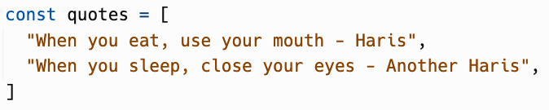
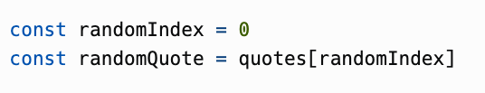
randomQuote
Therefore, with the randomIndex 0, what would randomQuote return us?
The first quote! Let’s see it step by step

Slide 43
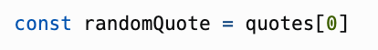
randomQuote
And since quotes[0] returns the first sentence, it should look like this…

Slide 44
randomQuote
This would then make randomQuote to return the first sentence. Go back a few slides to see again how it looks like.

Slide 45
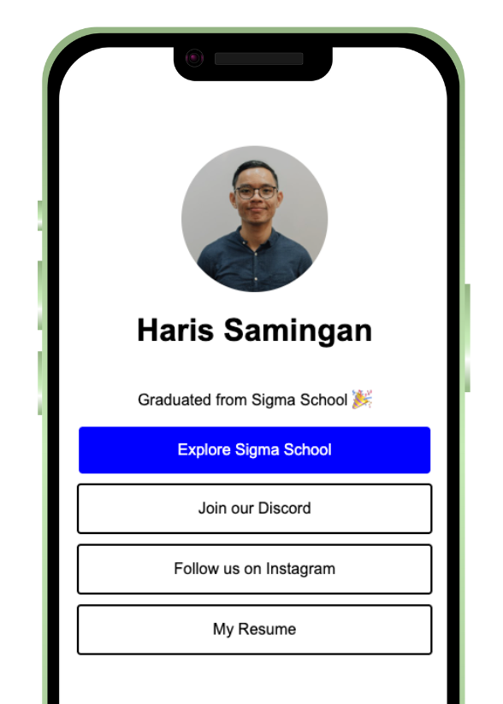
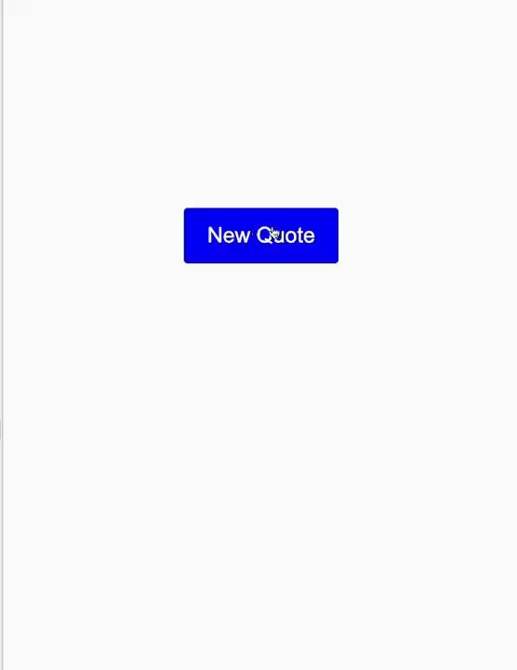

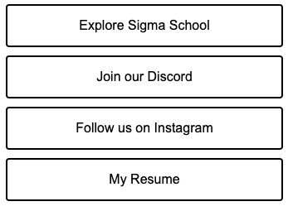
Challenge (Optional):
Notes:
Image from: Unsplash

Slide 46
Challenges (Optional)
Easy: Add more quotes!
Very Hard: Make image appear as well
1. Create an array of image urls. You can use this website: https://pravatar.cc/
2. Similar to randomQuote, get a randomPhoto
3. Google “assign dom element src” and click on w3schools. Read it and see if you can figure how to change an img src.
Developers normally have to search on their own. Answer is on the next slide!

Slide 47
Very Hard Challenge
Make random image appear as well.
1. Create an array of image urls. You can use this website: https://pravatar.cc/
2. Similar to randomQuote, get a randomPhoto
3. Google “assign dom element src” and click on w3schools. Read it and see if you can figure how to change an img src.
Developers normally have to search on their own. Answer is on the next slide!

Slide 48
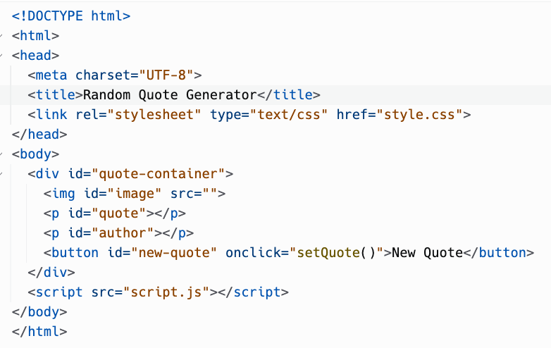
Answer for very hard challenge, index.html:

Slide 49
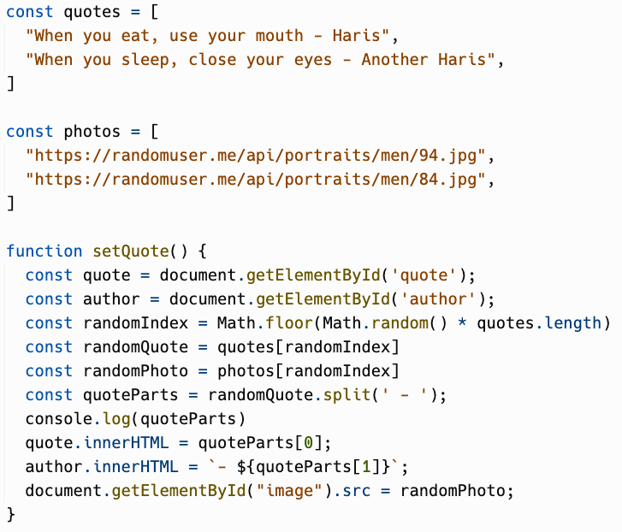
Answer for very hard challenge, script.js:

Slide 50

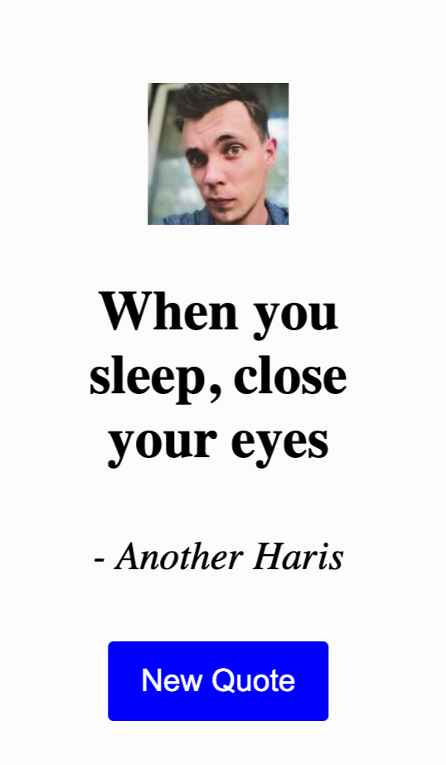
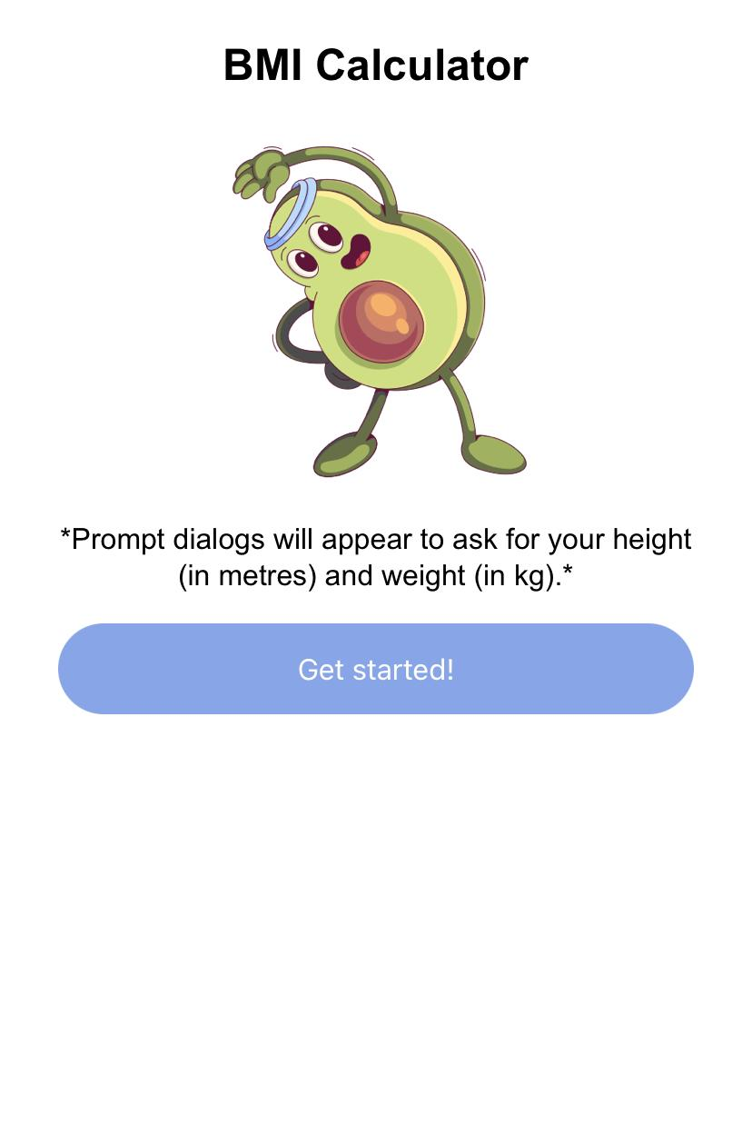
Congratulations!
You have created a random quote generator application!
Share it in our Discord channel here.
More specifically under the Share Your Achievements section > #i-built-this channel.

Slide 51

Good work. Now, gain points!
Now that you have completed this module, you can gain points by doing this survey:
https://forms.gle/FJzRxgVw7fS2DMPY9
You can gain up to 16 points!
Currently, you can get a free Sigma T-shirt for 150 points.
There will be more freebies in the future ~
Not real. Picture is for illustration purposes.

Slide 52
Full code here:
https://replit.com/@sigmaschooltech/quote-generator

Slide 53
Day 5 completed!

